Slide 1

Rationale
Organizations need analyzed, accurate, and updated information to take quick and effective business decisions.
This information should be readily available at a unified location such as dashboard in a presentable format. To achieve this, organizations need to gather, organize, manipulate, and analyze information.
Notes:
Explain the need of the organization by reading the rationale to the students. Tell the students that to fulfill the need of organization, students needs to have the following skills:
Organize and Manipulate Data
Perform Calculations with advanced formula
Organize worksheet and table data
Designing and creating a portal site
Organize and manage business data on portal sites
Programming using VBA
Write code to manipulate Excel objects
Analyze and Present Data
Create and modify charts
Analyze data using Pivot Tables and Pivot Charts
Insert graphic objects and enhance workbooks
Increase productivity and improve efficiency by streamlining your workflow
Present information on dashboard from conventional and LOB applications
Share and Collaborate Data
Collaborate with others using workbooks and audit worksheets
Work with multiple workbooks and import and export data
Use Excel with the web and structure workbooks with XML
Gather and share business data
To develop the listed skills in students a course is designed having name Analyzing and Presenting Business Data. This course comprises of following three books:
Microsoft Office Excel 2007 Level 2
Microsoft Office Excel 2007 Level 3
Analyzing and Presenting Business Data
Tell the students that Excel books focus on simplifying repetitive tasks by using formulas and displaying the spreadsheet data in a visually effective way by using templates, charts, and graphics. However, Analyzing and Presenting Business Data book focuses on developing portal sites and dashboards and tools to gather data from various sources.

Slide 2
Objectives
In this session, you will learn to:
  Manage cell and range names
  Calculate data across worksheets
  Use specialized functions
  Analyze data with logical and lookup functions
  Create and modify tables
  Format tables
  Sort or filter worksheet or table data
  Calculate data in a table or worksheet
Notes:
Share the session objectives with the students.

Slide 3
Manage Cell and Range Names
A range name:
  Is a method of referring to one or more cells with a descriptive label.
  Must start with a letter.
  Cannot contain spaces.
  Can be up to 255 characters long.
You can use the Name Manager to create, edit, and delete the range names.
Notes:
Before starting this session introduce the students to the new interface of Excel 2007. You can use the following link that beautifully explains this new interface and its working. This link provides an audio-based tutorial of Excel 2007.
http://office.microsoft.com/training/Training.aspx?AssetID=RP100620721033&CTT=6&Origin=RC100620751033
Use the slide to explain the concept of range names. A range name is used, instead of cell addresses for easy and better understanding of formulas. While constructing complex formulas, it is a best practice to use range names instead of cell addresses.
You can use the following link to explain how to create range name, adjust range name references, and delete range names. This link also provides tips for assigning range names.
http://www.uwec.edu/help/Excel07/rgnme.htm

Slide 4
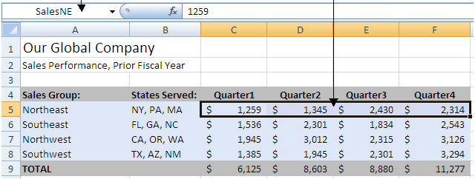
Manage Cell and Range Names (Contd.)
The following figure shows the range names.
Range name in name box
Selected Cell Range
SalesNE
SalesSE
SalesSW
SalesNW
Cells that use range names
Unique Range Names
Notes:
Use the figure given in the slide to discuss about the range names.
The worksheet, shown in the figure, provides the quarterly Sales performance data of four sales region of Our Global Company. The range C5:F5 is named as SalesNE, which is displayed in the name box. Similarly,C6:F6 cell range is named as SaleSE, C7:F7 cell range is named as SalesSW, and C8:F8 cell range is named as SalesNW.
You can explain the use of range names in analyzing business data , such as accounting data, by using the following link.
http://www.accountingweb.co.uk/cgi-bin/item.cgi?id=175623&d=1025&dateformat=%25o-%25B

Slide 5
Demo: Managing Range Names in Workbooks
Scenario:
  Your manager has asked you to substitute range names for cell ranges in a worksheet so that the formulas are easier to understand and less complicated when writing additional formulas.
Notes:
Discuss the scenario of Activity 1-1 of Lesson 1 in the Student Guide with the students.
You can access the data file for this activity from the following path in the TIRM CD:
TIRM\DATAFILES FOR FACULTY\LEVEL 2\Session_01\Lesson 1\Named Ranges.xlsx

Slide 6
Demo: Managing Range Names in Workbooks (Contd.)
Solution:
  To solve the preceding scenario, you need to perform the following tasks:
    Name the range B5:B8 Quarter 1.
    Create named ranges for Quarter 2 through Quarter 4 by using labels from the worksheet, and then create named ranges for the Sales Group regions.
    Use the Name Manager to rename the Sales groups.
    Calculate the total sales for East Coast and West Coast.
Notes:
Discuss the solution with the students. To demonstrate the solution, access the file provided at the following path in the TIRM CD:
TIRM\SOLUTIONS\Level 2\Demos\Lesson 1\My Named Ranges.xlsx

Slide 7
Calculate Data Across Worksheets
When you have data located in several different worksheets that is to be used in your calculations, you can calculate data across worksheets in a formula.
A three-dimensional (3-D) cell reference:
  Is a cell reference that is in the same location on multiple worksheets.
  Can be used only in a workbook with multiple worksheets.
Notes:
Use the slide to explain the students how to calculate data across worksheets. You can provide the following example to the students:
Peter is a Jr. Accounts Manager in Ranbank consultancy Ltd.. He is required to record the financial details of all the employees working in the Education department. He maintains a workbook with three worksheets consisting of the Basic pay, HRA (30 % of Basic Pay), and DA (40% of Basic Pay) details of employees. To calculate the monthly salary of a particular employee, Peter needs to add the individual’s information from all the three worksheets.
Discuss the problem statement with the students.
To demonstrate the solution, follow the following path in the TIRM CD:
TIRM\DATAFILES FOR FACULTY\LEVEL 2\Session_01\Emp_Sal.xlsx
Conclude the discussion saying that, to maintain the accuracy of the data, Peter made the calculations across worksheets instead of copying data from the three worksheets into a single worksheet, Salary.

Slide 8
Demo: Creating Formulas Across Multiple Worksheets
Scenario:
  Your manager asks you to create a summary page for a workbook that contains quarterly sales results for the last fiscal year. After inserting the summary as the first page, you set about making the calculations.
Notes:
Discuss the scenario of Activity 1-2 of Lesson 1 in the Student Guide with the students.
You can access the data file for this activity from the following path in the TIRM CD:
TIRM\DATAFILES FOR FACULTY\LEVEL 2\Session_01\Lesson 1\3D Formulas.xlsx
You can use the following link that excellently describes the use of Formulas in Excel 2007.
http://www.educationonlineforcomputers.com/blogs/Free_Microsoft_Office_Training_Tutorial_Resources.php

Slide 9
Demo: Creating Formulas Across Multiple Worksheets (Contd.)
Solution:
  To solve the preceding scenario, you need to perform the following tasks:
    Calculate consulting sales for the Northeast sales team for the entire fiscal year.
    Calculate marketing sales for the Northeast sales team for the entire fiscal year.
    Fill in the formulas for the rest of the Summary worksheet.
Notes:
Discuss the solution with the students. To demonstrate the solution, access the file provided at the following path in the TIRM CD:
TIRM\SOLUTIONS\Level 2\Demos\Lesson 1\My 3D Formulas.xlsx

Slide 10
Use Specialized Functions
Specialized functions enable you to perform advanced calculations, such as operations on specialized types of data.
Notes:
Pages 12 and 13 of the Students Guide discuss the 10 Function categories in Excel. Out of these 10 categories, emphasize much on the Text, Date & Time, and Logical function categories. You can open the Excel worksheet to show the working of Text, Date & Time, and Logical functions.
You can use the following link that excellently describes the basic and advanced functions in Excel 2007 in the topic Using Formulas and Functions in Microsoft Excel 2003.
http://www.educationonlineforcomputers.com/blogs/Free_Microsoft_Office_Training_Tutorial_Resources.php

Slide 11
Use Specialized Functions (Contd.)
Function syntax:
  It is the general form of the function that provides the structure for entering function arguments properly to return the desired results.
  The syntax shows:
    The names of the arguments.
    The proper order of the arguments.
    Whether arguments are required or are optional.

Slide 12
Use Specialized Functions (Contd.)
Function entry dialog boxes:
  Excel provides the following two dialog boxes to facilitate function entry by guiding you through selecting a function and its arguments:
    Insert Function
    Function Arguments
Notes:
Refer to Page 14 to give the descriptions for the two function entry dialog boxes mentioned in the slide.

Slide 13
Demo: Calculating with Dates and Using Text Functions
Scenario:
  Your company has decided to award employees who have 10 years of service with the company. You need to calculate years of service in your worksheet. Additionally, when employees details are entered in the worksheet, you want the labels to be in proper case rather than uppercase. You will convert the entries without retyping.
Notes:
Discuss the scenario of Activity 1-3 of Lesson 1 in the Student Guide with the students.
You can access the data file for this activity from the following path in the TIRM CD:
TIRM\DATAFILES FOR FACULTY\LEVEL 2\Session_01\Lesson 1\Text and Date Functions.xlsx

Slide 14
Demo: Calculating with Dates and Using Text Functions (Contd.)
Solution:
  To solve the preceding scenario, you need to perform the following tasks:
    Enter the function that will always display the current date in cell H2.
    Enter the formula that will calculate years of service in cell F4 and duplicate the formula for all employees.
    Change the First and Last name columns from all uppercase to proper case without retyping every entry.
Notes:
Discuss the solution with the students. To demonstrate the solution, access the file provided at the following path in the TIRM CD:
TIRM\SOLUTIONS\Level 2\Demos\Lesson 1\My Text and Date Functions.xlsx

Slide 15
Demo: Using Formulas to Separate Data into Separate Columns
Scenario:
  Your employee information includes a column of data called Office Location. That single column provides the building, office number, and phone extension for each employee. You would like to have separate columns for the phone extension as well as the building.
Notes:
Discuss the scenario of Activity 1-4 of Lesson 1 in the Student Guide with the students.
You can access the data file for this activity from the following path in the TIRM CD:
TIRM\DATAFILES FOR FACULTY\LEVEL 2\Session_01\Lesson 1\My Text and Date Functions.xlsx

Slide 16
Demo: Using Formulas to Separate Data into Separate Columns (Contd.)
Solution:
  To solve the preceding scenario, you need to perform the following tasks:
    Enter the function that will separate the extension into column H.
    Enter the function that will separate the building information into column I.
Notes:
Discuss the solution with the students. To demonstrate the solution, access the file provided at the following path in the TIRM CD:
TIRM\SOLUTIONS\Level 2\Demos\Lesson 1\My Text and Date Functions_2.xlsx

Slide 17
Analyze Data with Logical and Lookup Functions
Logical functions:
  And
  False
  If
  Iferror
  Not
  Or
  True
Each Logical function analyzes the contents of a cell:
  The function then returns a value, either true or false, depending upon whether the cell contents match the function requirements.
Notes:
Logical and Lookup & Reference functions are the specialized functions used to analyze data in Excel.
Discuss Figure 1-1 given in page 19. The figure shows the use of the IF function in a worksheet to determine if the budget plan is under or over the budget amount of $100. In addition, refer to pages 20 and 21 to discuss about the various logical functions.
Later discuss the complete slide.
You can use the following link that excellently describes the use of Advanced Functions in Excel 2007.
http://www.educationonlineforcomputers.com/blogs/Free_Microsoft_Office_Training_Tutorial_Resources.php

Slide 18
Demo: Using Logical and Lookup Functions
Scenario:
  According to the HR policies of a company, there will be a quarterly increment of 10,000 of the employees who satisfy either of the following conditions:
    Performance rating is of the highest value, 4 and age is >= 50
    Designation is of a Manager
Notes:
Discuss the scenario with the students to define the working of the IF, AND, and OR logical functions. Ask them to give their solutions. After 10 minutes, discuss the solution with the students. To demonstrate the solution, access the file provided at the following path in the TIRM CD:
TIRM\SOLUTIONS\Level 2\Scenario\Logical_functions.xlsx

Slide 19
Analyze Data with Logical and Lookup Functions (Contd.)
The Lookup & Reference functions find data in another location based on data in the current worksheet.
Data used in a Lookup & Reference function can be in the same workbook or in another workbook.
Lookup & Reference functions are primarily used as part of a formula.
Notes:
The Lookup & Reference functions enable you to retrieve accurate data directly from the source.

Slide 20
Analyze Data with Logical and Lookup Functions (Contd.)
The HLOOKUP function:
  Searches horizontally across a table’s column headings to locate and retrieve information from the column.
  Has the following syntax:
    HLOOKUP(lookup_value, table_array, row_index_num, range_lookup)
The VLOOKUP function:
  Searches vertically across a table’s column headings to locate and retrieve information from the row.
  Has the following syntax:
    VLOOKUP(lookup_value, table_array, col_index_num, range_lookup)
Notes:
You can use the following link that excellently describes the use of Advanced Functions in Excel 2007 with examples.
http://www.educationonlineforcomputers.com/blogs/Free_Microsoft_Office_Training_Tutorial_Resources.php

Slide 21
Demo: Entering Functions that Apply Logical Analysis
Scenario:
  You are a sales manager and have set up a compensation structure such that a 1% bonus will be given to all employees who meet their goal. Additionally, a bonus of 1% will given on each category with sales greater than $115,000. If employees exceed their set goal and get a bonus in two or more categories, they will be rewarded with a President’s Club vacation.
Notes:
Discuss the scenario of Activity 1-5 of Lesson 1 in the Student Guide with the students.
You can access the data file for this activity from the following path in the TIRM CD:
TIRM\DATAFILES FOR FACULTY\LEVEL 2\Session_01\Lesson 1\Logical.xlsx

Slide 22
Demo: Entering Functions that Apply Logical Analysis (Contd.)
Solution:
  To solve the preceding scenario, you need to perform the following tasks:
    Enter the function that calculates the goal bonus for all employees.
    Enter the formula that will calculate the Category Bonus for the employees.
    Enter the function that calculates the number of times each employee received a bonus for a category.
    Enter the function that will display whether the employee is invited to President’s Club.
Notes:
Discuss the solution with the students. To demonstrate the solution, access the file provided at the following path in the TIRM CD:
TIRM\SOLUTIONS\Level 2\Demos\Lesson 1\My Logical.xlsx

Slide 23
Demo: Locating Part Numbers with the HLOOKUP and VLOOKUP Function
Scenario:
  You are creating a file for your customer service department to use. When a customer calls in, the customer service employee needs to quickly have the part number available in order to help the customer. The customer will provide the model year and model number, and your worksheet should calculate the correct part number.
Notes:
Discuss the scenario of Activity 1-6 of Lesson 1 in the Student Guide with the students.
You can access the data file for this activity from the following path in the TIRM CD:
TIRM\DATAFILES FOR FACULTY\LEVEL 2\Session_01\Lesson 1\Lookup Tables.xlsx

Slide 24
Demo: Locating Part Numbers with the HLOOKUP and VLOOKUP Function (Contd.)
Solution:
  To solve the preceding scenario, you need to perform the following tasks:
    Create a function that will return the correct part number, for model year 1998 and model number 500.
    Change the Model Year and then the Model Number.
    Calculate the correct part number for any given model number.
Notes:
Discuss the solution with the students. To demonstrate the solution, access the file provided at the following path in the TIRM CD:
TIRM\SOLUTIONS\Level 2\Demos\Lesson 1\Lookup Tables.xlsx

Slide 25
Create and Modify Tables
A table:
  Is a section of contiguous rows and columns within a worksheet.
  Is used to hold worksheet data and makes some worksheet operations easier.
  Has column headers and row headers.
  Can contain any number of rows and columns depending on the available data.
  Can contain blank or non-blank cells.
Notes:
Introduce this topic as a tool for organizing data in Microsoft Office 2007.

Slide 26
Create and Modify Tables (Contd.)
Table Components:
  A table contains the following components that can be used to enhance a presentation:
    Table title
    Rows
    Columns
    Header row
    Total row
    Banded row
    Banded column

Slide 27
Create and Modify Tables (Contd.)
The Create Table dialog box:
  Enables you to select a range of data to create a table.
  Gives you the option of adding headers to your table.
Styles and Quick Style sets:
  A style is a named collection of formatting options that you can apply as a group.
  A Quick Style set is a group of styles that are selected to coordinate with each other and reflect the overall theme of a worksheet.
The Table Tools Design Contextual tab that appears when a table is selected contains the tools to design tables in a worksheet.
Notes:
To discuss about the various groups under the Table Tools Design contextual tab refer to Page 32.

Slide 28
Demo: Creating and Manipulating Tables
Scenario:
  You need to manipulate and analyze data for a meeting. You want to draw attention to certain portions of the data and have decided to convert the data into a table to take advantage of the flexibility of formatting in tables.
Notes:
Discuss the scenario of Activity 2-1 of Lesson 2 in the Student Guide with the students.
You can access the data file for this activity from the following path in the TIRM CD:
TIRM\DATAFILES FOR FACULTY\LEVEL 2\Session_01\Lesson 2\Tables.xlsx

Slide 29
Demo: Creating and Manipulating Tables (Contd.)
Solution:
  To solve the preceding scenario, you need to perform the following tasks:
    Convert the Inventory sheet data into a table by inserting a table.
    Convert the Employee data into a table by formatting as a table.
    Delete a product from the Inventory table and insert a new row for grout.
    Insert an Order Date column in the table.
    Remove duplicate rows in a table.
Notes:
Discuss the solution with the students. To demonstrate the solution, access the file provided at the following path in the TIRM CD:
TIRM\SOLUTIONS\Level 2\Demos\Lesson 2\My Tables.xlsx

Slide 30
Format Tables
To present the data in a table effectively, you can apply different table-specific formatting options to customize the table.
The table formatting tools in Excel enable you to:
  Customize the format of individual tables.
  Save the custom table formats.
Notes:
Use the slide to discuss how to apply table-specific formatting options and how to customize the table format.
A table that uses the default formats might not be visually appealing to a user, and the information might not be clearly identified. So, a user can customize the format of an individual table.

Slide 31
Demo: Formatting a Table
Scenario:
  You are preparing the worksheet for distribution. You want to emphasize the employee names with a different font and style. All columns should be highlighted with the same color. The color scheme should be orange.
Notes:
Discuss the scenario of Activity 2-2 of Lesson 2 in the Student Guide with the students.
You can access the data file for this activity from the following path in the TIRM CD:
TIRM\DATAFILES FOR FACULTY\LEVEL 2\Session_01\Lesson 2\Tables.xlsx

Slide 32
Demo: Formatting a Table (Contd.)
Solution:
  To solve the preceding scenario, you need to perform the following tasks:
    Change the font of the first column of the Employees table to Arial Black.
    Emphasize the first column of the table and make banded columns.
    Apply a different color theme to the table.
Notes:
Discuss the solution with the students. To demonstrate the solution, access the file provided at the following path in the TIRM CD:
TIRM\SOLUTIONS\Level 2\Demos\Lesson 2\My Tables.xlsx

Slide 33
Demo: Creating a Custom Table Style
Scenario:
  After formatting a couple of tables to meet your department specifications, you want to create a custom style that conforms to the following specifications so that you can easily apply that quick style:
    Use a heavy line outline around the entire table.
    Use orange as the color for the entire table.
    Emphasize the header row by using the bold italic style.
Notes:
Ask the students to study the scenario given in Activity 2-3 of Lesson 2 in the Student Guide. Discuss the scenario with the students. You can access the data file for this activity from the following path in the TIRM CD:
TIRM\DATAFILES FOR FACULTY\LEVEL 2\Session_01\Lesson 2\Tables.xlsx

Slide 34
Demo: Creating a Custom Table Style (Contd.)
Solution:
  To solve the preceding scenario, you need to perform the following tasks:
    Display the New Table dialog box.
    Select the formatting options for Whole Table and Header Row.
    Apply the newly created custom table style to the Inventory table.
Notes:
Discuss the solution with the students. To demonstrate the solution, access the file provided at the following path in the TIRM CD:
TIRM\SOLUTIONS\Level 2\Demos\Lesson 2\My Tables.xlsx

Slide 35
Sort or Filter Worksheet or Table Data
Sorting:
  Sort is a method of viewing data that arranges all the data into a specific order.
  Data can be sorted in either ascending order or descending order.
  Data can be sorted on a single criterion or multiple criteria.
Notes:
Use the slide to explain how a sort method helps to manipulate the table data. When data is sort, it is possible to create different views of the same data without altering its original format.

Slide 36
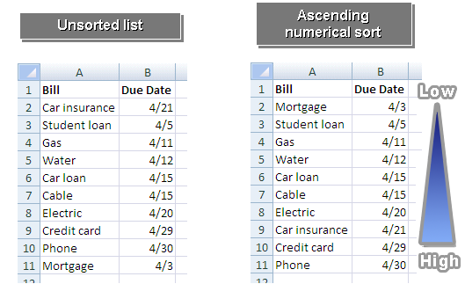
Sort or Filter Worksheet or Table Data (Contd.)
The following figures show the single-level sort in ascending order.
Ascending Numerical Sort
Unsorted List
Low
High
Notes:
Use the figures given in the slide above to explain the sort method. The sort method is applied to the Due Date column of the unsorted list, shown in the slide.

Slide 37
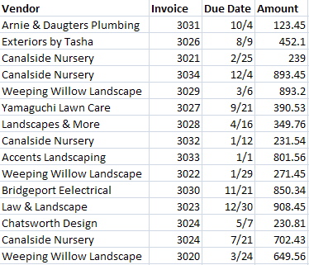
Sort or Filter Worksheet or Table Data (Contd.)
The following figure shows an unsorted list.
Unsorted List
Numerical
Alphabetical

Slide 38
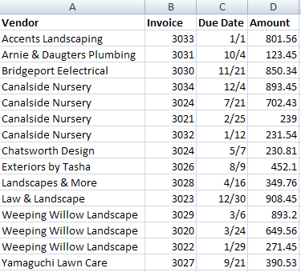
Sort or Filter Worksheet or Table Data (Contd.)
The following figure shows a multiple-level sort in both ascending and descending orders.
Criterion 1
Criterion 2
Sorted List
Low
High
Low
High
High
Low
Alphabetical Ascending Order
Numerical Descending Order
Notes:
The figure in the above slide shows how two criteria's are applied within a single worksheet on the same table. Criteria 2 has been sorted in descending according to the Vendor column. For example, for Weeping Willow Landscape and Canalside Nursery Vendors, the Amount column is sorted in descending order.

Slide 39
Sort or Filter Worksheet or Table Data (Contd.)
Filters:
  A filter is a method of viewing data that shows only the data that meets a criterion.
  Data can be filtered on a single criterion or multiple criteria using numeric and alphabetic information.
  A filter can rearrange the data in the current table or worksheet range, or copy the information to another location.
Notes:
Use the slide to discuss the filter method used to manipulate data.
Refer to Page 47 to discuss about the various filter operators.

Slide 40
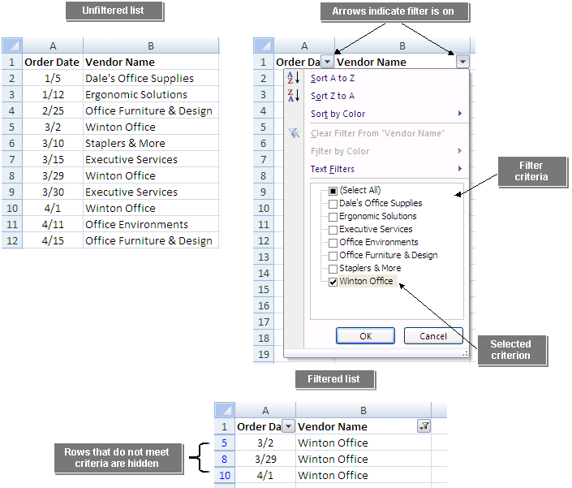
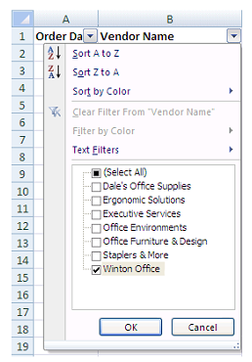
Sort or Filter Worksheet or Table Data (Contd.)
The following figures show the unfiltered and filtered data.
Unfiltered List
Arrows indicate filter is on
Filter Criteria
Filtered List
Rows that do not meet criteria are hidden
Selected Criterion
Notes:
Use the figures given in the slide above to discuss the filter method.

Slide 41
Demo: Sorting and Filtering Tables
Scenario:
  You want to quickly look up employees by having your employee table sorted. You will need to add a new employee to your list so you will be required to re-sort the employees for the new employee to be displayed in the correct physical order. Your manager has asked you for a list of only those employees in the Account Department who have been employed for 10 years or more. After you create the list, you want to display all employees to make future filters easier.
Notes:
Discuss the scenario of Activity 2-4 of Lesson 2 in the Student Guide with the students.
You can access the data file for this activity from the following path in the TIRM CD:
TIRM\DATAFILES FOR FACULTY\LEVEL 2\Session_01\Lesson 2\Tables.xlsx

Slide 42
Demo: Sorting and Filtering Tables (Contd.)
Solution:
  To solve the preceding scenario, you need to perform the following tasks:
    Sort the Employees table by last name in alphabetical order.
    Add a new employee and reapply the sort by Last name.
    Sort the employee table to show the primary order by Department and then by employees who have been employed the longest as the secondary order.
    Display only those employees in the Accounting department with 10 years of service or more.
    Display all employees.
Notes:
Discuss the solution with the students. To demonstrate the solution, access the file provided at the following path in the TIRM CD:
TIRM\SOLUTIONS\Level 2\Demos\Lesson 2\My Tables.xlsx

Slide 43
Calculate Data in a Table or Worksheet
When you perform a calculation in a worksheet, you have to choose the data you want included in the calculation:
  This can be very time-consuming if there is a large amount of data.
A database function can find the data you are looking for and perform the calculation all in one step.
Summary functions in tables:
  If your table has a totals row, you can use the drop-down list for each total cell to insert summary results for that column of the table.

Slide 44
Calculate Data in a Table or Worksheet (Contd.)
A database function:
  Performs a calculation only on data that meets certain criteria.
  Starts with the letter D.
  Has three arguments:
    The database
    The field
    The criteria
The following figure shows a database function.
Database Function
Arguments
=DAVERAGE(B1:C17,2,I1:I2)
Function Name
Database
Criteria
Field

Slide 45
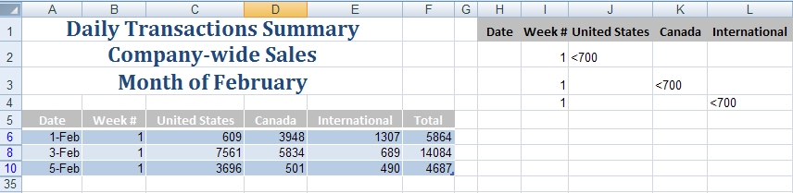
Calculate Data in a Table or Worksheet (Contd.)
AND and OR conditions:
  In an AND condition, criteria appear in multiple columns on the same row in the criteria range.
  In an OR condition, criteria appear in multiple rows in the criteria range.
The following figure shows the AND and OR conditions.
OR Criteria
(separate rows)
Filter records to display Week 1 AND United Sates OR Week 1 AND Canada OR Week 1 AND International
where less than 700 products shipped.
AND Criteria
(same row)
Notes:
Tell the students that in Excel 2007, the AND function can contain a maximum of 255 conditions. For earlier versions of Excel, the limit is 30 conditions.

Slide 46
Calculate Data in a Table or Worksheet (Contd.)
A subtotal:
  Is a function performed on a subset of the data in a worksheet data range that has been sorted.
  Can be created using several functions such as sum, average, and count.
Notes:
A worksheet can have as many subtotal functions as required. You cannot subtotal tables. If there is a need to subtotal table data, then it is required to convert the table to a data range.

Slide 47
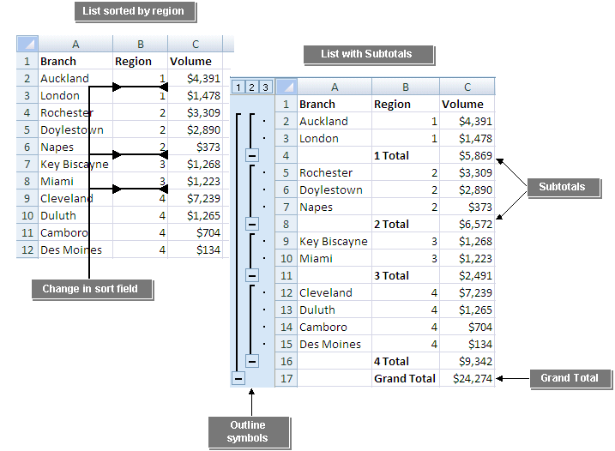
Calculate Data in a Table or Worksheet (Contd.)
The following figures show the subtotal function.
List sorted by region
List with subtotals
Subtotals
Change in sort field
Grand Total
Outline Symbols
Notes:
The figures in the above slide consist of two lists, one sorted by region and other consists of subtotals. The second list shows the grand total of all the subtotals.

Slide 48
Demo: Applying Calculations to a Table or Worksheet
Scenario:
  You have been asked to provide some figures based on the February Sales. The Sales Manager has asked for a list of all the days when total sales were in excess of $8,000. Based on that list, he would like to know the total sales, average sales, and total number of days on the list. Later he requests a list of days when any one on the regions had sales totaling less than $1,000. Finally, he would like a list of all sales for February subtotaled by week.
Notes:
Discuss the scenario of Activity 2-5 of Lesson 2 in the Student Guide with the students.
You can access the data file for this activity from the following path in the TIRM CD:
TIRM\DATAFILES FOR FACULTY\LEVEL 2\Session_01\Lesson 2\Tables.xlsx

Slide 49
Demo: Applying Calculations to a Table or Worksheet (Contd.)
Solution:
  To solve the preceding scenario, you need to perform the following tasks:
    Calculate the number of days when the total sales for the company is greater than 8000.
    Create a summary area on the worksheet that calculates total, average, and count of the days that the total sales is greater than 8000.
    Perform an advanced filter on the February Sales Calculations list to show all days in February when either the U.S., Canada, or International regions had sales less than 1000.
    Subtotal the February Sales data by week.
Notes:
Discuss the solution with the students. To demonstrate the solution, access the file provided at the following path in the TIRM CD:
TIRM\SOLUTIONS\Level 2\Demos\Lesson 2\My Tables.xlsx

Slide 50
Summary
In this session, you learned that:
  A range name is a method of referring to one or more cells with a descriptive label.
  A three-dimensional (3-D) cell reference is a cell reference that can be used only in a workbook with multiple worksheets.
  Function syntax is the general form of the function that provides the structure for entering function arguments properly.
  The lookup and reference functions find data in another location based on data in the current worksheet.
  A table is a section of contiguous rows and columns within a worksheet that Excel treats as an independent data set.
  A sort is a method of viewing data that arranges all the data into a specific order.
  A filter is a method of viewing data that shows only the data that meets a criterion.
Notes:
Use the Summary slides to summarize the session.
You can also use the following link for more information on Excel 2007. This link provides a demo on Excel 2007. This link needs Quicktime software to be installed.
http://www.softwaretrainingtutorials.com/excel-2007.php

Slide 51
Summary (Contd.)
  A database function performs a calculation only on data that meets certain criteria.
  A filter is a method of viewing data that shows only the data that meets a criterion.
  A database function performs a calculation only on data that meets certain criteria.
Notes:
Use the Summary slides to summarize the session.
You can also use the following link for more information on Excel 2007. This link provides a demo on Excel 2007. This link needs Quicktime software to be installed.
http://www.softwaretrainingtutorials.com/excel-2007.php

